Slide 1
Excel VBA - Basics
VBA is Easier than Excel
Notes:
I wanted to talk to the audience as if I know everything but in realaity I am justing reading out

Slide 2
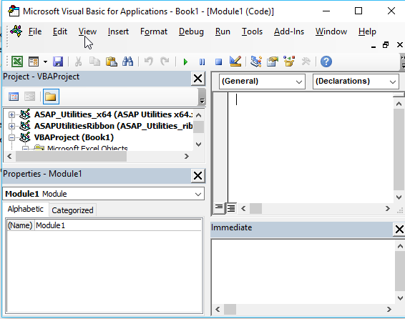
VBE Explained
1
2
2.
Project Window
3.
Module Properties
4.
Code Window
5. Immediate Window
1. Command Ribbon
3
5
4
Notes:
Sfja’sl’jfslfj;asljf;asljfl;asfj

Slide 3
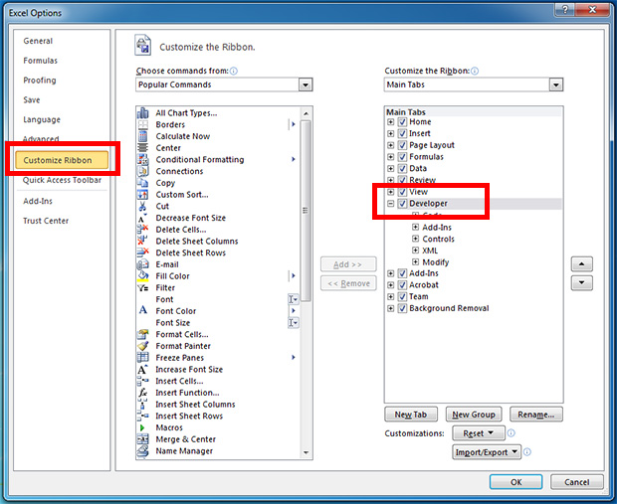
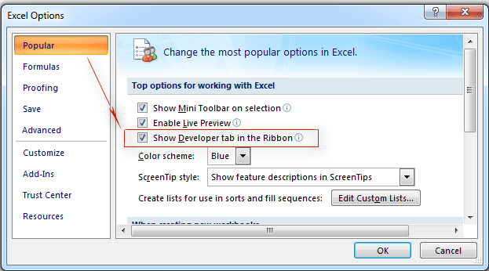
Excel Security Settings
Explanation Demo
This depends upon the version of excel used by the user
Excel 2010 and So on
Excel 2007

Slide 4
Your First Macro – Vijay Notes
A Demo and Practice by Student
A Sub Routine
A Function
Explaining VBE elements thru a Code
Recording a Macro
Understanding the Code of a recorded Macro
Watching the Code written in VBE while recording

Slide 5
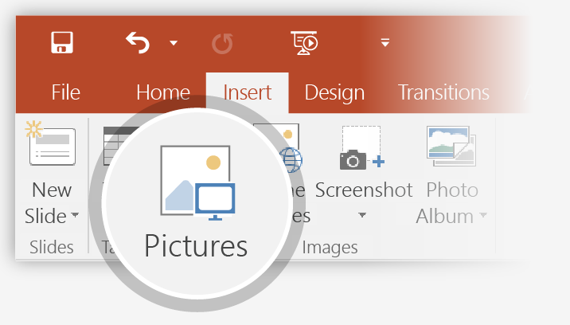
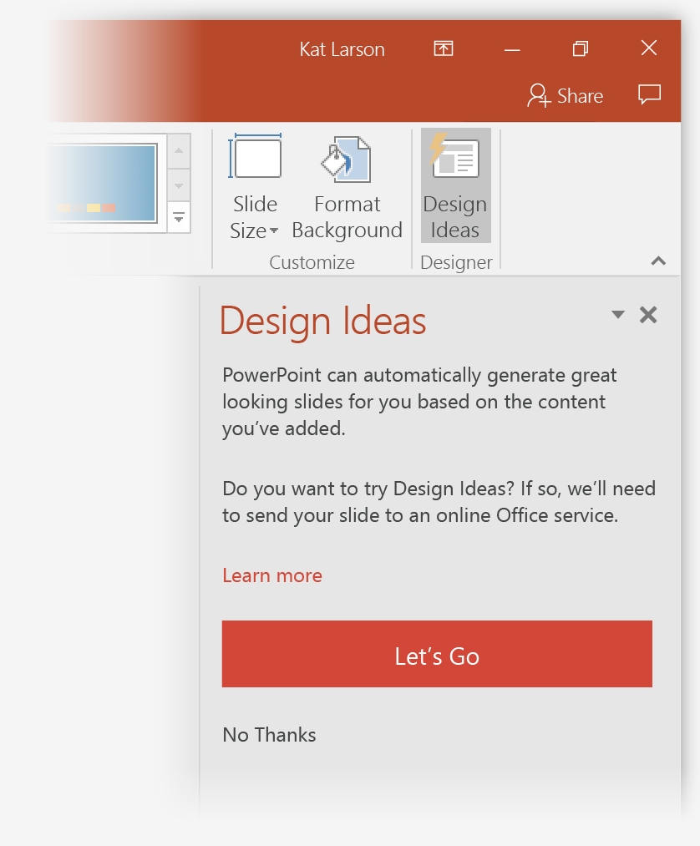
How to use PowerPoint Designer
How it works:
1
Start a new presentation by going to File > New > Blank Presentation.
2
On the very first slide, add a picture: Go to Insert > Pictures or Insert > Online Pictures and choose the picture. Hint: You need to be online when you add the picture.
3
When PowerPoint asks your permission to get design ideas, select Let's Go.
4
Choose a design you like from the Design Ideas task pane.

Slide 6
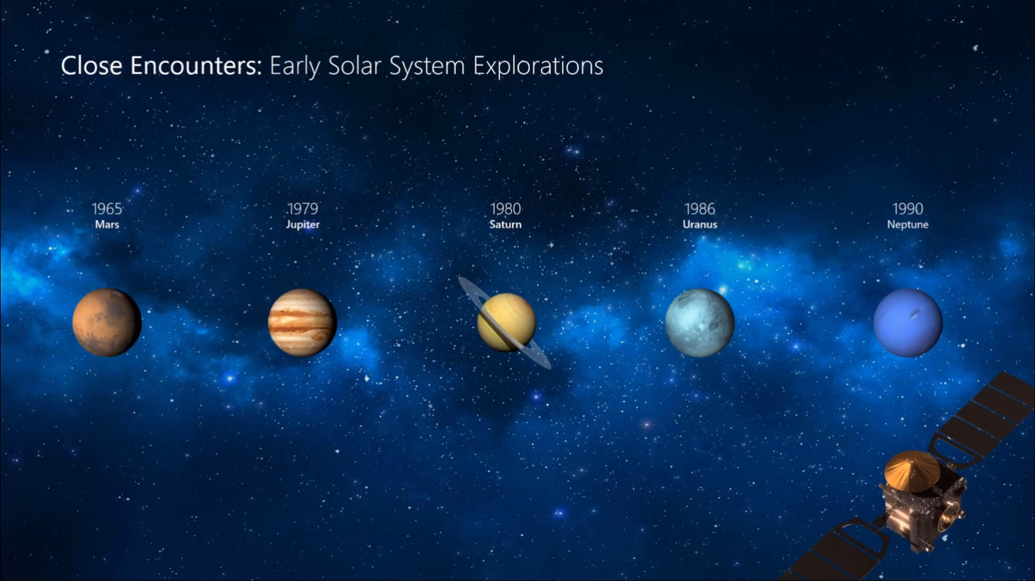
Morph
Morph makes smooth animations and object movements in your presentation. You use two similar slides to perform the animation, but it looks to your audience like the action happens on one slide.
Play the video on the right to see a quick example.
Morph is a subscription-only feature. If you have an Office 365 subscription, you can try it yourself with the steps on the next slide.

Slide 7
How to use PowerPoint Designer
How it works:
1
Start a new presentation by going to File > New > Blank Presentation.
2
On the very first slide, add a picture: Go to Insert > Pictures or Insert > Online Pictures and choose the picture. Hint: You need to be online when you add the picture.
3
When PowerPoint asks your permission to get design ideas, select Let's Go.
4
Choose a design you like from the Design Ideas task pane.

Slide 8

Designer helps you get your point across
PowerPoint Designer suggests professional designs for your presentation, based on the content in your slides.
Designer is a subscription-only feature. If you have an Office 365 subscription, the next slide shows you how it works in a new presentation.

Slide 9

Welcome to PowerPoint
5 tips for a simpler way to work

Slide 10
Designer helps you get your point across
PowerPoint Designer suggests professional designs for your presentation, based on the content in your slides.
Designer is a subscription-only feature. If you have an Office 365 subscription, the next slide shows you how it works in a new presentation.

Slide 11
How to use PowerPoint Designer
How it works:
1
Start a new presentation by going to File > New > Blank Presentation.
2
On the very first slide, add a picture: Go to Insert > Pictures or Insert > Online Pictures and choose the picture. Hint: You need to be online when you add the picture.
3
When PowerPoint asks your permission to get design ideas, select Let's Go.
4
Choose a design you like from the Design Ideas task pane.

Slide 12
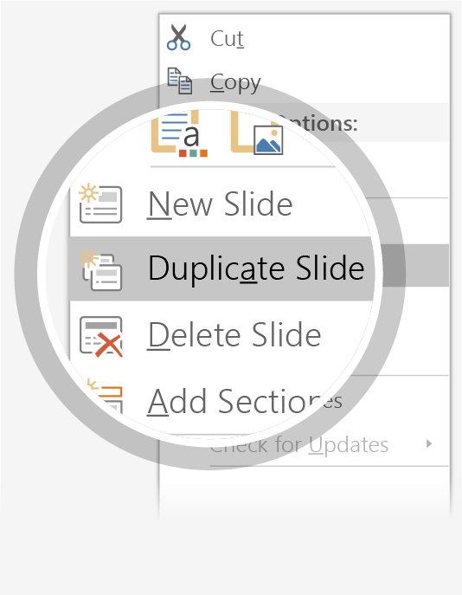
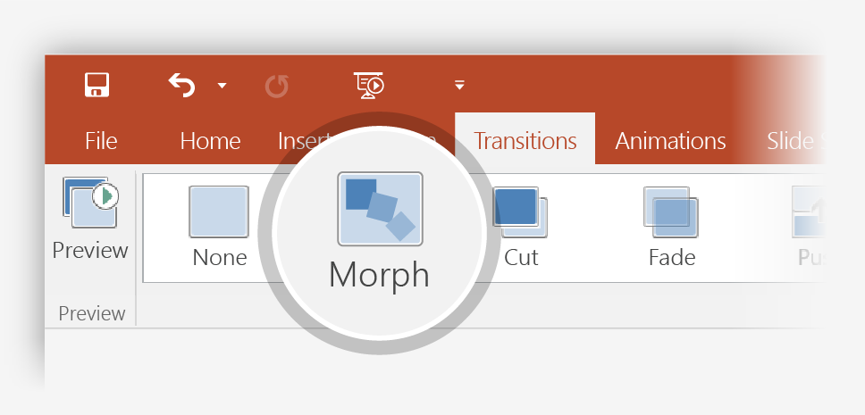
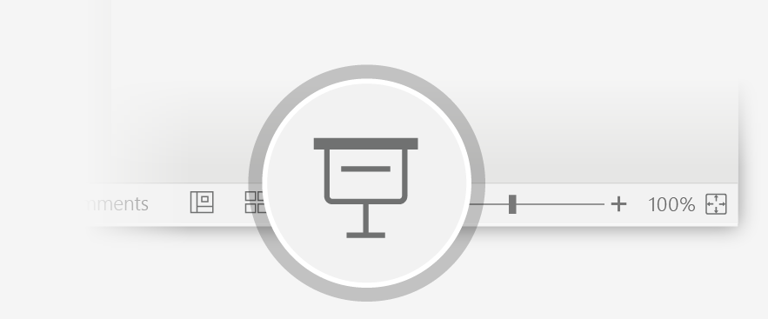
Setting up Morph
Try it yourself with these two simple “planets”:
1
Duplicate this slide: Right-click the slide thumbnail and select Duplicate Slide.
2
In the second of these two identical slides, change the shapes on the right in some way (move, resize, change color), then go to Transitions > Morph.
3
Return to the first of the two slides and press Slide Show button and then select Play to see your circle morph!
Hint: Effect Options gives you even more options for Morph.

Slide 13
Morph
Morph makes smooth animations and object movements in your presentation. You use two similar slides to perform the animation, but it looks to your audience like the action happens on one slide.
Play the video on the right to see a quick example.
Morph is a subscription-only feature. If you have an Office 365 subscription, you can try it yourself with the steps on the next slide.

Slide 14
Procedures
Procedures are a group of statements executed as a whole, which instructs Excel how to perform a specific task.
The task performed can be a very simple or a very complicated task.
VBA manipulates objects. Excel provides dozens and dozens of objects that you can manipulate. Examples of objects include a workbook, a worksheet, a cell range, a chart, and a shape. You have many more objects at your disposal, and you can manipulate them by using VBA code.
However, it is a good practice to break down complicated procedures into smaller ones.

Slide 15
Function Procedures
A function is a group of reusable code, which can be called anywhere in your program. This eliminates the need of writing the same code over and over again.
This helps the programmers to divide a big program into a number of small and manageable functions.
Apart from inbuilt Functions, VBA allows to write user-defined functions as well and statements are written between Function and End Function.

Slide 16
SUB Procedures
Sub-procedures work similar to functions. While sub procedures DO NOT Return a value, functions may or may not return a value.
Sub procedures CAN be called without call keyword. Sub procedures are always enclosed within Sub and End Sub statements.

Slide 17
calling A PROCEDURE
Function procedures are UDFs hence should be used in excel directly like predefined functions viz SUM(), VLOOKUP() etc. However you can call a Function procedure from (within) Sub
Procedure
Sub procedures CAN be called in various ways.
1. From the command ribbon
2. From Immediate Window
3. From Excel
4. With Form Control or ActiveX Control

Slide 18
Working With Ranges
Worksheets(“Sheet1”).Range(“A1:C5”)
Worksheets(“sheet1”).range(“a1”,”c5”)
Workbooks(“Budget.xlsx”).Worksheets(“Sheet1”).Range(“A1:C5”)
Range(“Pricelist”) – Name ranges in Excel
Range(“3:3”) – Row Range
Range(“A:A”) – Column Range
Range(“A1:B8,D9:G16”)= 3 noncontiguous ranges

Slide 19
Working with ranges
Range("C1:C10 A6:E6") = 3 intersection is a single cell
Range("A1,A3,A5,A7,A9") = 4
Range("A1:D10").Cells(41) = 2000
ActiveCell.Cells(2, 1) = 5
ActiveSheet.Cells(3, 4) = 7

Slide 20
Other ways to refer range
Worksheets(“Sheet2”).Cells(2, 3)
Range(“A1:H10”).Value = 99
Range(Cells(1, 1), Cells(10, 8)).Value = 99
OFFSET Property
Range(“A1”).Offset(1, 2) - one row two columns forward
Range(“C2”).Offset(-1, -2) – one row two columns backward
Range(“A1”).Offset(0, 0) – no impact
ActiveCell.Offset(0,1) = Time – adding value with offset formula

Slide 21
Value property
Using Value Property
MsgBox Worksheets(“Sheet1”).Range(“A1”).Value
Value property cannot be used for this code
MsgBox Worksheets(“Sheet1”).Range(“A1:C3”).Value
Try this – this code puts 123 in the all cells in the range defined
Worksheets(“Sheet1”).Range(“A1:C3”).Value = 123
Note : Value is the default property, it will be considered by VBA if you omits
Worksheets(“Sheet1”).Range(“A1:C3) = 123

Slide 22
Text, Count, Column, range, Address Properties
Text Property brings what value in the range in text format
MsgBox Worksheets(“Sheet1”).Range(“A1”).Text
The Count property returns the column number of a single-cell range
Msgbox range(“a1:e3”).Count
The Column and Range property returns the respective number of cells in a range
MsgBox Range(“C3”).column
Msgbox Range (“E1”).Row
Address Property
MsgBox Range(Cells(1, 1), Cells(5, 5)).Address

Slide 23
Formula and number format property
Range(“A13”).Formula = “=SUM(A1:A12)”
Range(”A13”).Formula = ”=SUM(A1:A12)&”” Stores”””
Columns(“A:A”).NumberFormat = “0.00%”
Columns(“A:A”).NumberFormat = “0.0,,”
Columns(“A:A”).NumberFormat = “$ 0.00,,”

Slide 24
Methods
Range("A1").Select
Range("A1").Copy
Range("A1").Delete
ActiveSheet.Paste Destination:=Range("B1")
Workbooks("MyBook.xlsx").Protect , True, False

Slide 25
Using comments
Using Comments within the Procedure always will be helpful for the author and user to understand why the code is used and how it is used.
We can write comments for each statement in the procedure
Either with Single Quote (‘) or with REM we can create comments within the code which are not be code statements but will be just plain text and highlighted in a different color

Slide 26
Message Box
The MsgBox function displays a message box and waits for the user to click a button and then an action is performed based on the button clicked by the user.
Syntax – MsgBox(Prompt…..)
Prompt − A Required Parameter. A String that is displayed as a message in the dialog box. The maximum length of prompt is approximately 1024 characters. If the message extends to more than a line, then the lines can be separated using a carriage return character (Chr(13)) or a linefeed character (Chr(10)) between each line.
Buttons − An Optional Parameter. A Numeric expression that specifies the type of buttons to display, the icon style to use, the identity of the default button, and the modality of the message box. If left blank, the default value for buttons is 0.

Slide 27
MsgBox Continued
Title − An Optional Parameter. A String expression displayed in the title bar of the dialog box. If the title is left blank, the application name is placed in the title bar.
Helpfile − An Optional Parameter. A String expression that identifies the Help file to use for providing context-sensitive help for the dialog box.
Context − An Optional Parameter. A Numeric expression that identifies the Help context number assigned by the Help author to the appropriate Help topic. If context is provided, helpfile must also be provided.

Slide 28
InputBOX
The InputBox function prompts the users to enter values. After entering the values, if the user clicks the OK button or presses ENTER on the keyboard, the InputBox function will return the text in the text box. If the user clicks the Cancel button, the function will return an empty string ("").

Slide 29
Excel OBJECT Hierarchy
Excel Object Collections
Excel
Work Book
Cells
Values
Range
Color
Font
Color
Font
Work Sheet

Slide 30
Navigating thru Object Hierarchy
Application Object -
Work Book Object - application.workbooks(“book1.xlsx”)
Work Sheet Object - application.workbooks(“book1.xlsx”).worksheets(“Sheet1”) or
application.workbooks(“book1.xlsx”).worksheets(1)
Range Object - application.workbooks(“book1.xlsx”).worksheets(1).Range(“a1”)
application.workbooks(“book1.xlsx”).worksheets(1).Range(“a1”).value=500

Slide 31
Object Methods
Using Message Box
Msgbox workbooks.count
Count Method (above code)
Calculate Method worksheets(“sheet1”).range(“a1”).calculate
Activate Method Worksheets(“Sheet1”).activate
range(a1).copy range(b1)
Copy Method
Add Method workbooks.Add

Slide 32
variables
Variable is a named memory location used to hold a value that can be changed during the script execution. Following are the basic rules for naming a variable.
You must use a letter as the first character.
You can't use a space, period (.), exclamation mark (!), or the characters @, &, $, # in the name.
Name can't exceed 255 characters in length.
You cannot use Visual Basic reserved keywords as variable name.
Syntax – WE need to declare variable with “Dim”

Slide 33
Types of variables / Data Types
There are many VBA data types, which can be divided into two main categories, namely numeric and non-numeric data types.
Name | Type | Details
Byte | Numerical | Whole number
Integer | Numerical | Whole number
Long | Numerical | Whole number between
Currency | Numerical | Fixed decimal number.
Single | Numerical | Floating decimal number
Double | Numerical | Floating decimal number
String | Text | Text.
Date | Date | Date and time.
Boolean | Boolean | True or False.
Object | Object | Microsoft Object.
Variant | Any type | Any kind of data (default type if the variable is not declared).

Slide 34
Numeric Data Types
Type | Range of Values
Byte | 0 to 255
Integer | -32,768 to 32,767
Long | -2,147,483,648 to 2,147,483,648
Single | -3.402823E+38 to -1.401298E-45 for negative values 1.401298E-45 to 3.402823E+38 for positive values.
Double | -1.79769313486232e+308 to -4.94065645841247E-324 for negative values 4.94065645841247E-324 to 1.79769313486232e+308 for positive values.
Currency | -922,337,203,685,477.5808 to 922,337,203,685,477.5807
Decimal | +/- 79,228,162,514,264,337,593,543,950,335 if no decimal is use +/- 7.9228162514264337593543950335 (28 decimal places).

Slide 35
Non-Numeric Data Types
Type | Range of Values
String (fixed length) | 1 to 65,400 characters
String (variable length) | 0 to 2 billion characters
Date | January 1, 100 to December 31, 9999
Boolean | True or False
Object | Any embedded object
Variant (numeric) | Any value as large as double
Variant (text) | Same as variable-length string

Slide 36
Why Variable
Let
Let us see an example to understand why variable required
Create
Create a multiplication Table, without Variable and with Variable
Option
Option Explicit – Why required

Slide 37
Understanding usage of Variable
Byte
Integer
Long
https://www.youtube.com/watch?v=Yh2YOWj86Jk&index=14&list=PLWQB3PEUJKRmEpWZxmJOMXBzKKI0_9G04

Slide 38

WILD Characters
Data Type | Wild Character
Integer | %
Long | &
Single | !
Double | #
Currency | @
String | $

Slide 39
Scope of variables
Local Variable
The scope of this variable end after specific procedure
Module-wide Variables
The scope of this variable ends after specific module
Public Variables
The scope of this variable is for all Modules in the worksheet
Static Variables
Static variables are a special case. They’re declared at the procedure level, and they retain their value when the procedure ends normally. However, if the procedure is halted by an End statement, static variables do lose their values. Note that an End statement is not the same as an End Sub statement.

Slide 40
Constants
Using constants throughout your code in place of hard-coded values or strings is an excellent programming practice.
For example, if your procedure needs to refer to a specific value (such as an interest rate) several times, it’s better to declare the value as a constant and use the constant’s name rather than its value in your expressions.
This technique not only makes your code more readable, it also makes it easier to change should the need arise — you have to change only one instruction rather than several.

Slide 41
Examples
Sub test ()
Dim local Variable….
Dim Modulewidevariable
Sub test ()
…..
End Sub
Public Modulewidevariable
Sub test ()
…..
End Sub
Sub test ()
Static Variable….
Const NumQuarters as Integer = 4
Const Rate = .0725, Period = 12
Const ModName as String = “Budget Macros”
Public Const AppName as String = “Budget Application”

Slide 42



Object Variables
Normal defined variables are given value after they are defined
In case of Object variables we need to give value with a start word as “SET”
After declaring Object Variable, that will be appearing in default variable list
CTRL Spacebar

Slide 43

Examples – Variable THRU ^{DIM}
Sub Test()
1
Dim my_name as string
2
My_name = “Vijay”
3

Slide 44
Examples – Object Variable THRU ^{set}
Sub Test()
1
Dim rng as Range
2
Set rng = Range(“B3”)
3

Slide 45
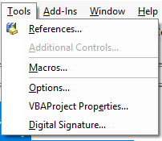
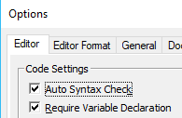
Option Explicit
Write a code with Declaration of Variable as below:
Sub test()
Dim my_range As Byte
my_range = 4
Range("A1").Value = my_range
Range("A2").Value = my_rage * 2
End Sub
Excel cannot understanding what is happening around. And after running macro we get 0 as result. But actually it should give a error message
Option Explicit statements helps us to declare the variable declared explicitly:

Slide 46
Few Examples
Example one during class (Other Examples will be provided as exercises)
Declare Variables ( name, salary, Tax paid)
Using If/Endif and offset (If the name and salary are “”(null) then exit sub
Define values for name and salary
Use constant to define tax rates
Use select case statement to decide tax payment
Use message box to announce the tax amount

Slide 47
Macro Code
Sub test()
' Declare varaibles
Dim sal As Double
Dim name As String
Dim tax_paid As Double
' if the selected cell is ""
If ActiveCell.value = "" Then
MsgBox "no name selected"
Exit Sub
End If
If ActiveCell.Offset(0, 1).value = "" Then
MsgBox "No Salary selected"
Exit Sub
End If
'define the values for declared variables
name = ActiveCell
sal = ActiveCell.Offset(0, 1).value
'declare constatns for tax rates
Const rate1 As Double = 0.15
Const rate2 As Double = 0.2
Const rate3 As Double = 0.25
' use Case statement
Select Case sal
Case Is < 14000
tax_paid = rate1 * sal
End Select
MsgBox name & " has to pay" & tax_paid & " as Tax"
End Sub

Slide 48
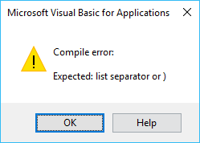
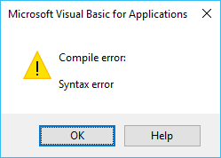
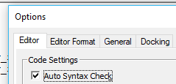
ERROR and debugging
To select a Cell we Write - Range(“a1”).select
IF we write Range(“a1).select
When we write
IF we write Range(“a1”.select
To Avoid These irritating box msgbox we can goto Tools - >
UNCHECK the option

Slide 49
aDD-In
How to make our code as a Add-in
How to access the Add-in from any excel spreadsheet

Slide 50

Few things to remember
Sub Test() – instead of calling them as brackets, let us call them as parenthesis
Code - You perform actions in VBA by executing VBA code. You write (or record) VBA code, which is stored in a VBA module.
Module - VBA modules are stored in an Excel workbook file, but you view or edit a module by using Visual Basic Editor (VBE). A VBA module consists of procedures
Procedures: A procedure is basically a unit of computer code that performs some action. VBA supports two types of procedures: Sub procedures and Function procedures.

Slide 51
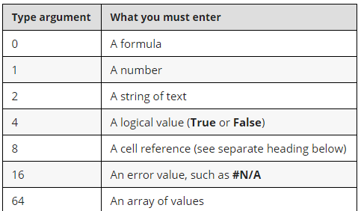
Type

Slide 52
Few things to remember
Excel Objects : Excel provides more than 100 classes of objects to manipulate
Objects include worksheet, workbook, range, cell and so on..
Object Hierarchy (Refer Object Hierarchy slide)
Active Objects - Worksheets(“Sheet1”).Range(“A1”) , (if you know the sheet 1 is active, you can simplify this as Range(“A1”)
Object properties : A Range object has got Value and Address;
A Chart type as has got A Title and Type

Slide 53
Few more to know for better coding
VBA Variables
Object Methods
Standard programming constructs – arrays, conditional statements, loops
Events – VBA is a Event Driven program

Slide 54
Creating a perfect macro
Start Recording
From A1 onwards type 1,2,3,4,5 till A5
Select and color it
Stop It

Slide 55
Explanation to change the code Working with Range and Cell objects
Declare object variable
Set the object variable
Cells(row, column) to enter all 5 numbers
With selection
.Style = “Comma”
.Font.Bold = True
.Font.Italic = True
End with

Slide 56
The Cell Property
object.Cells(rowIndex, columnIndex)
object.Cells(rowIndex)
object.Cells
Examples
Worksheets(“Sheet1”).Cells(1, 1) = 9
ActiveSheet.Cells(3, 4) = 7
ActiveCell.Cells(1, 1) = 5
Range(“A1:D10”).Cells(5) = 2000

Slide 57
The offset property
object.Offset(rowOffset, columnOffset)
ActiveCell.Offset(1,0).Value = 12
The next example enters a value of 15 in the cell directly above the active cell:
ActiveCell.Offset(-1,0).Value = 15

Slide 58
Few more examples
Record a macro with “Relative Reference”
That shows how offset works

Slide 59
Controlling code execution
GoTo statements
If-Then constructs
Select Case constructs
For-Next loops
Do While loops
Do Until loops

Slide 60
If , Then , EndIF
Record a simple macro with some Method
Edit the code with If, then and Endif

Slide 61
For Counter and next counter / For Next
Create an activity with relative reference twice
Edit macro with For Counter and Next Counter
Sub DeleteRows()
Dim RowNum As Long
For RowNum = 10 To 2 Step -2
Rows(RowNum).Delete
Next RowNum
End Sub
Sub sumOdd_test()
Dim Sum As Double
Dim Count As Integer
Sum = 0
For Count = 1 To 100 Step 2
Sum = Sum + Sqr(Count)
Next Count
MsgBox Sum
End Sub

Slide 62
ERROR Handling
What are run time errors
The on error statement
Ignoring errors
Creating a error Handler
Resuming after an error
Testing for the type of errors
Raising Custom Errors

Slide 63
What is run time error
A Runtime error is “error occurs while program is running”, and there are several codes of runtime errors and indicated with different number codes
Other errors are
“Syntax Error” – is a formula error and indicates error in statement
“Compile Error” – if the code is not compiled properly like instead of writing Worksheets,
if used Worksheet.

Slide 64
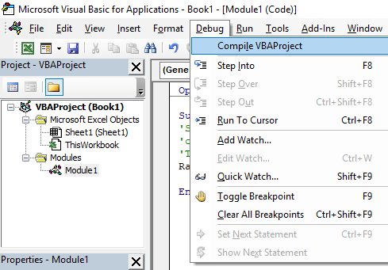
Finding compiling errors in the code

Slide 65
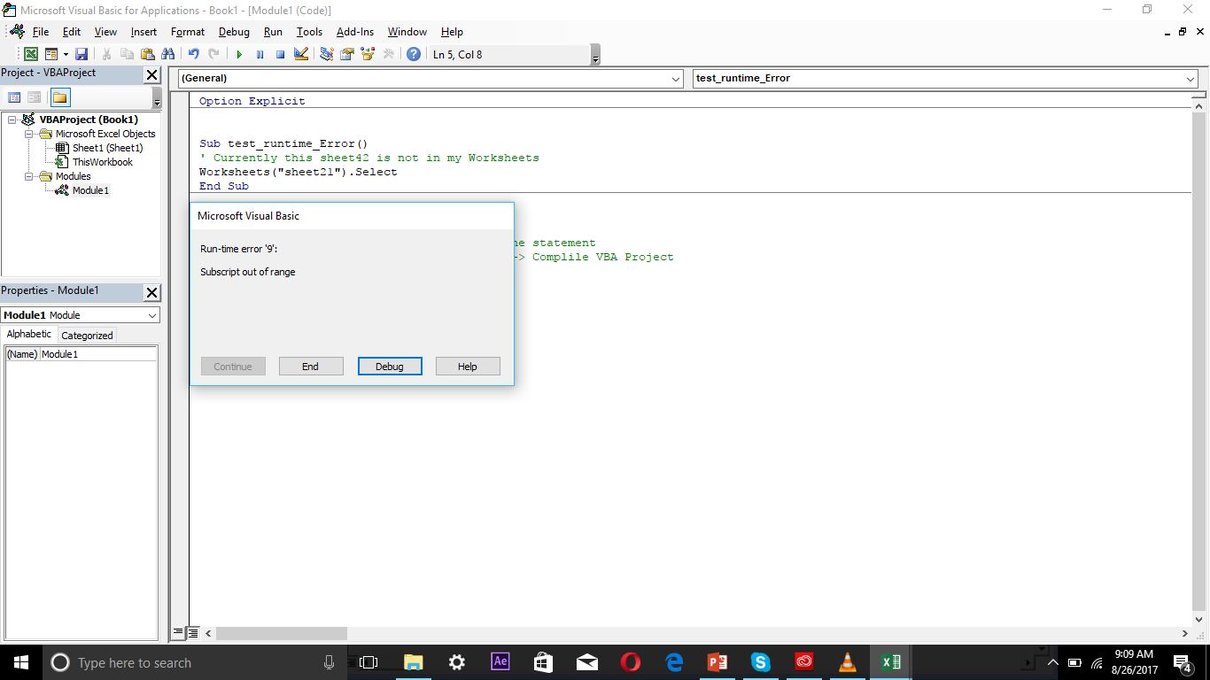
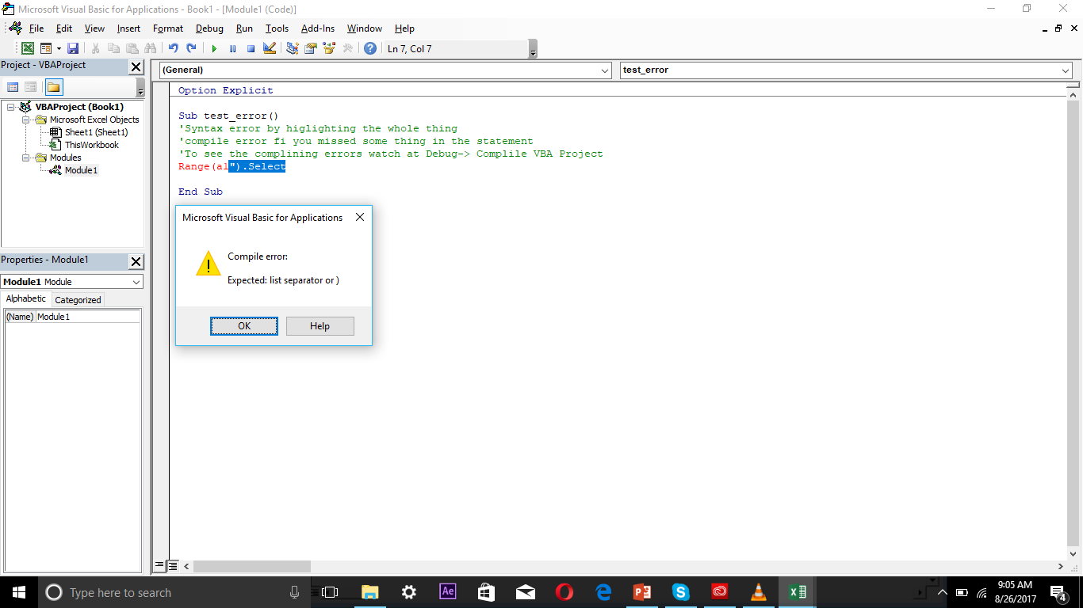
Compile Error and Debugging
Stops the Subroutine running
Breaks into the sub routine to rectify the code

Slide 66
Ignoring run time errors
Check the code with Debug or F8 option to see how the code is behaving
On Error statement , which need to invoked before the procedure which needs execution the code is “ On error resume next”
Example : Worksheets(“Sheet23”).Delete , then on error resume next is useful and In that case the code ignore the statement and moves forward
“ But this will not solve the problem in few cases and may cause some other issues and your code turns useless ”

Slide 67
What next - on error goto statement
In case of Resume next , the code ignore any error and moves but do not give resolution
In such case we need to write the code as below:
On error resume next GoTo createsheet (an optional name)
And at the end of the code we need to write our optional name Createsheet:
createSheet:
Worksheet.add.name = “Sheet23”
Code tries to understand whether sheet is there if not it will add
Check the code with Debug or F8 option to see how the code is behaving

Slide 68
Using resume next
Incase you wanted to write further code
Onerror goto createsheet
Worksheets(“sheet23”).select
Range(“A1”).value = now
Exit sub
Createsheet:
worksheets.add.name = “Sheet23”
resume next
Check the code with Debug or F8 option to see how the code is behaving

Slide 69
On error goto 0
After adding the new sheet, if we run the code it actually throws error when you declare resume next
We can avoid that with “ON ERROR GOTO 0”

Slide 70
For Each Next Statement

Slide 71
Array
An array is a group of variables. In Excel VBA, you can refer to a specific variable (element) of an array by using the array name and the index number.
Function MonthNames(Optional MIndex)
Dim AllNames As Variant
Dim MonthVal As Long
AllNames = Array("Jan", "Feb", "Mar", "Apr", "May", "Jun", _
"Jul", "Aug", "Sep", "Oct", "Nov", "Dec")
If IsMissing(MIndex) Then
MonthNames = AllNames
Else
Select Case MIndex
Case Is >= 1
' Determine month value (for example, 13=1)
MonthVal = ((MIndex - 1) Mod 12)
MonthNames = AllNames(MonthVal)
Case Is <= 0 ' Vertical array
MonthNames = Application.Transpose(AllNames)
End Select
End If
End Function

Slide 72
Few important functions in VBA
Ucase
Lcase
Mod
Proper

